Slide 1

Telecom Churn Prediction System
Customer churn is defined as a tendency of customers to abandon a brand and stop spending money on payment of particular business products.. The percentage of customers that discontinue using a product offered by a company or packages during a particular time period is what they term as customer churn rate or attrition rate.
Churn may be the largest problem facing telecom companies in particular. According to business consultants around the world, Customer retention is way better than looking for new ones and more cost friendly. And so being able to predict customer defection is important as a business function. We are going to use a structured data set called Telco-Customer -Churn .csv from www.kaggle.com.

Slide 2
Problem Statement
Customer churn is a disadvantage and one of the biggest worries of large companies. This is due to its direct effect on the company’s revenues, take a case of telecom business. We need to find means of predicting potentiality of customers churning using a computer based churn prediction methodology that is capable of accurately identifying any loss of clients in advance, so that proactive retention strategies can be deployed in a bid to retain the customer. So,trying to figure out factors that increase customer churn is very important to take necessary measures to reduce this vice’s effects on this business. Our major task is coming up with a churn prediction model which will assist Telco telecom company operators in predicting customers who are most likely to churn.

Slide 3
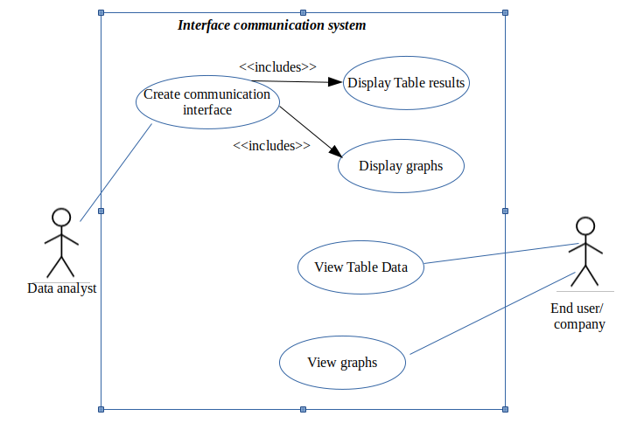
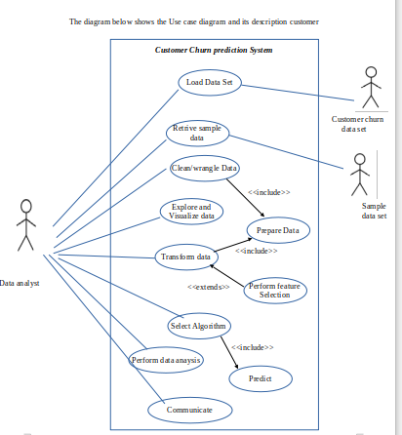
Use case diagrams

Slide 4
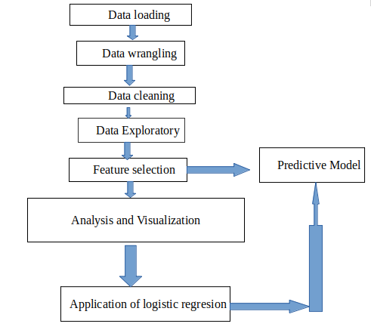
Data Pipeline flow

Slide 5
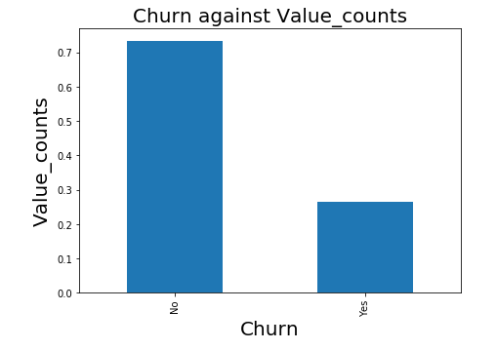
Visualization
A graph showing the Churn against Value_counts.

Slide 6
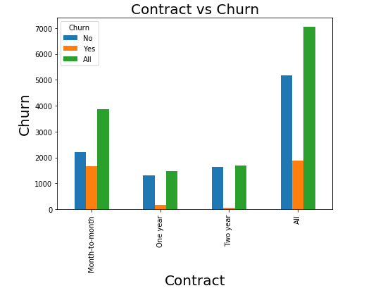
More graphs
The graph of customers contracts against churn.

Slide 7
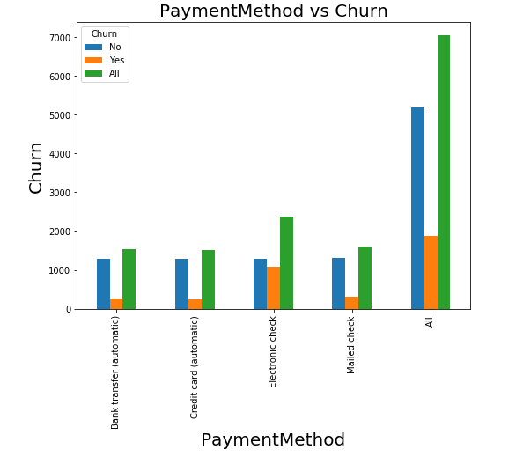
More graphs
The graph showing different payment methods against Churn

